Slide 1

DESIGNING MONOLITH FIRST FOR MICROSERVICE ARCHITECTURE
Halil İbrahim Kalkan

Slide 2

Agenda
TODO: ...

Slide 3
INTRODUCTION
DESIGNING MONOLITH FIRST FOR MICROSERVICE ARCHITECTURE

Slide 4

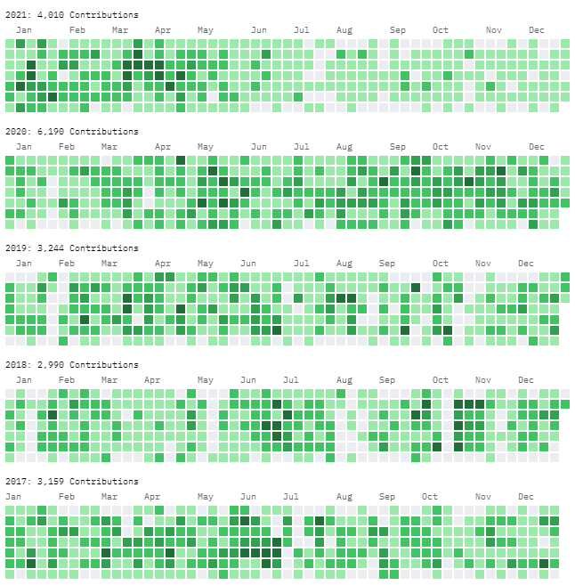
About me: Halil İbrahim Kalkan
halilibrahimkalkan.com
GitHub: hikalkan
Twitter: hibrahimkalkan

Slide 6
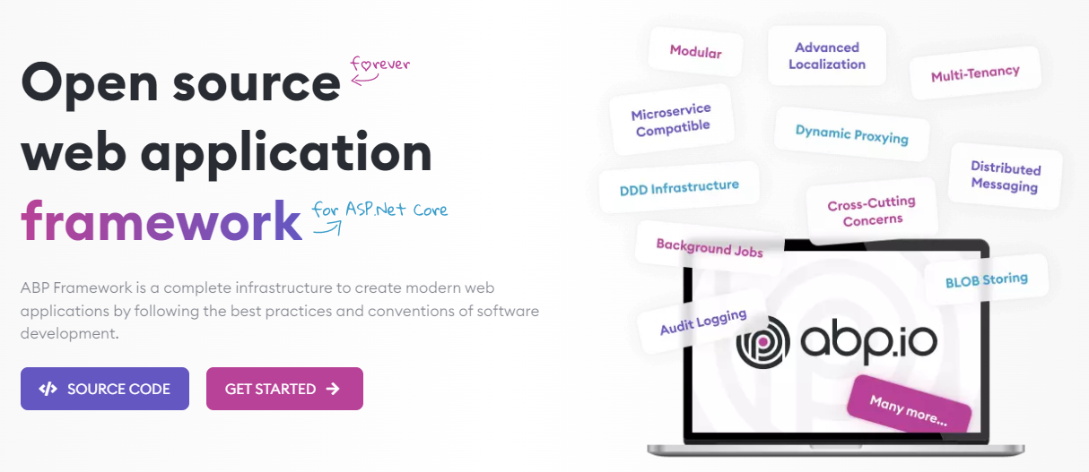
The ABP FRAMEWORK project https://abp.io --- https://github.com/abpframework

Slide 7
ABP Framework: Architecture
Domain Driven Design
& Layered Solution
Modular
Multi-Tenancy (SaaS infrastructure)
Microservice ready

Slide 8
ABP Framework: Infrastructure Enterprise application requirements
Cross-cutting concerns
Authentication & authorization
Distributed event bus
Audit logging
Background jobs
Data filtering & soft-delete
Dynamic client-side proxies
Dynamic forms
…more

Slide 9
ABP Framework: Startup templates

Slide 10
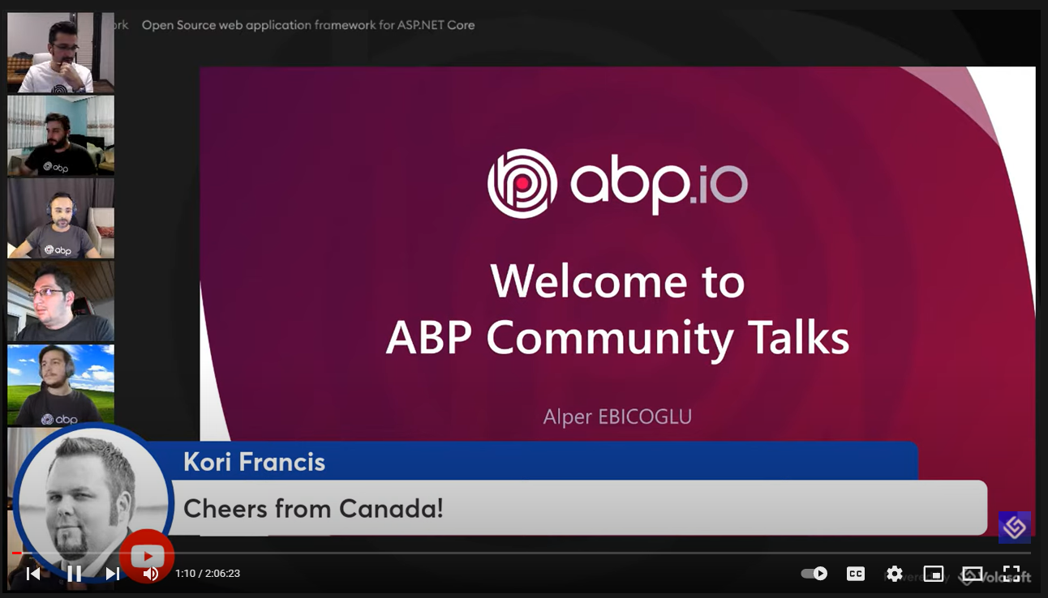
ABP Framework: The community
GitHub
8K stars
24,000 commits
238 contributors
6,200 issues & 5,200 PRs closed
NuGet
128 releases
5M downloads (only for the core package)
ABP Community Talks

Slide 11
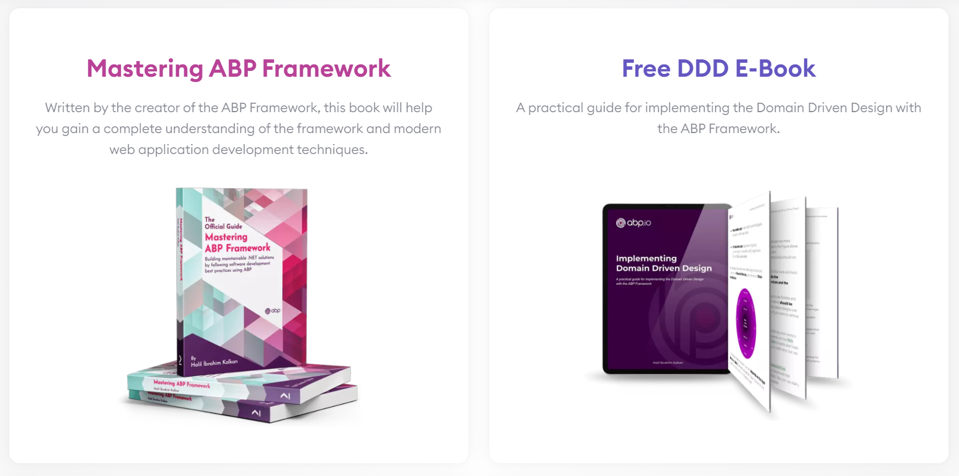
ABP Framework: Books

Slide 12
eShopOnX projects
eShopOnContainers (by Microsoft) https://github.com/dotnet-architecture/eShopOnDapr
Simplified and containerized microservice example
Show drafts of different architectural patterns
Not production ready
eShopOnDapr (by Microsoft) https://github.com/dotnet-architecture/eShopOnDapr
Based on eShopOnContainers, powered by Dapr
Focuses on demonstrating the Dapr features
More production ready, applicable and maintainable
eShopOnAbp (by Volosoft) https://github.com/abpframework/eShopOnAbp
Reference solution for microservice development with the ABP Framework and state-of-the-art tools
Production ready, easy to develop and maintain

Slide 13
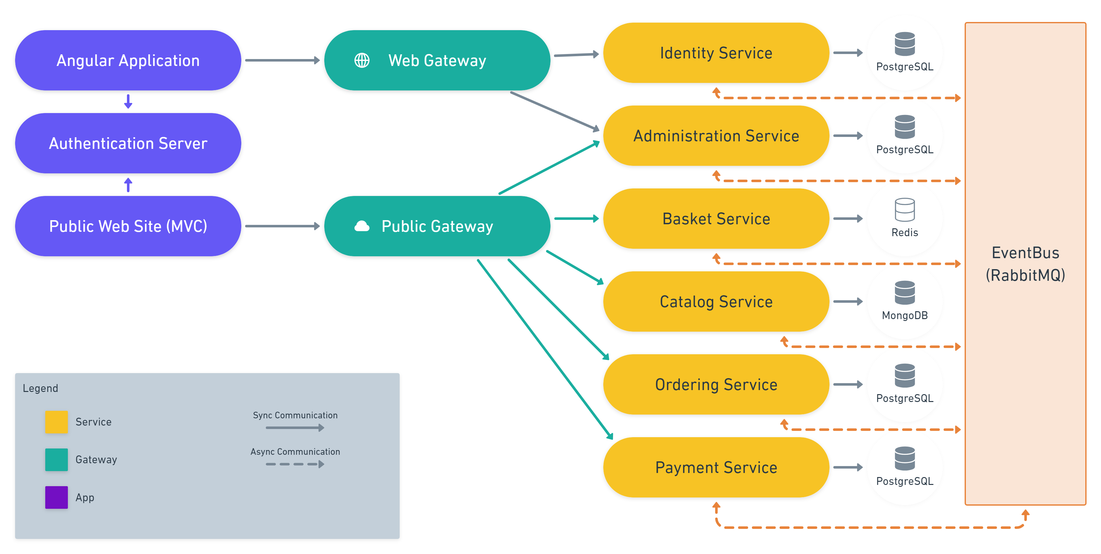
eShopOnAbp https://github.com/abpframework/eShopOnAbp

Slide 14
eShopOnAbp https://github.com/abpframework/eShopOnAbp
TODO: More details and the book!

Slide 15
Microservice trade-offs
BENEFITS
Forcing the modularity and encapsulation
Independently developed, deployed and scaled
Technology diversity
COSTS
Distribution
Eventually consistency
Operational complexity
Reference: https://martinfowler.com/articles/microservice-trade-offs.html

Slide 16


Microservices: Who is for?
Large development team with DevOps and automation culture
Large, complex and mature business or domain

Slide 17
Microservices: Who is for?
TODO: most business don’t need it!

Slide 18
Monolith first: What?
TODO: ...

Slide 19
Monolith first: Why?
TODO: ...

Slide 20
Title
TODO: ...

Slide 21
Title
TODO: ...

Slide 22
DESIGNING A MODULAR MONOLITH
DESIGNING MONOLITH FIRST FOR MICROSERVICE ARCHITECTURE

Slide 23
Title
TODO: ...

Slide 24
Title
TODO: ...

Slide 25
MIGRATING TO MICROSERVICES
DESIGNING MONOLITH FIRST FOR MICROSERVICE ARCHITECTURE

Slide 26
Title
TODO: ...

Slide 27
Title
TODO: ...

Slide 28
Title
TODO: ...

Slide 29
Title
TODO: ...

Slide 30
Title
TODO: ...

Slide 31
Title
TODO: ...

Slide 32
Title
TODO: ...

